Slide 1
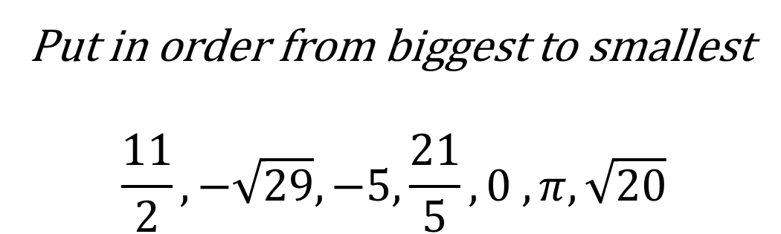

Bell Work
Evaluate:
(40+24) / 8 $−$ ($2^{2}−$1)
Put in order from biggest to smallest
$$\frac{11}{2},−\sqrt{29}, −5, \frac{21}{5}, 0 , π, \sqrt{20}$$

Slide 2
From Last Time… Let’s Chat!
From Today:
Page 15 #1-3, 13-22 (on same number line), 50, 66
Mixed Review:
Page 17 #75, 80, 81, 82

Slide 3
ALGEBRA 3
Day 7

Slide 4
Chapter 1 Section 3 Algebraic Expressions
Objective: Simplify Expressions
Chapter 1 Section 4 Solving Equations
Objective: Solving 2-3 Step Equations

Slide 5
Order of Operations
PEMDAS (work left to right)
P = parenthesis (Please)
E = exponents (Excuse)
M = multiplication (My) *Multiplication and Division at the same
D = division (Dear) time must be worked from left to right*
A = addition (Aunt) *Addition and Subtraction at the same
S = subtraction (Sally) time must be worked from left to right*
If there are no variables, use the “Run Matrix” menu option
from the calculator to check your work!

Slide 6
1.3 Evaluating Expressions (note: no = sign)
Evaluating the expression = replacing the variables with numbers
In other words… Write Algebraic Expression → Replace Variables → Simplify
Examples:
1.) Evaluate the following: 3(x +2) – 6x – 8 when x = 4
Note: could we simplify first?
2.) Evaluate the following: 5y + (8 – x) + 2xy when x = – 2
y = 3

Slide 7
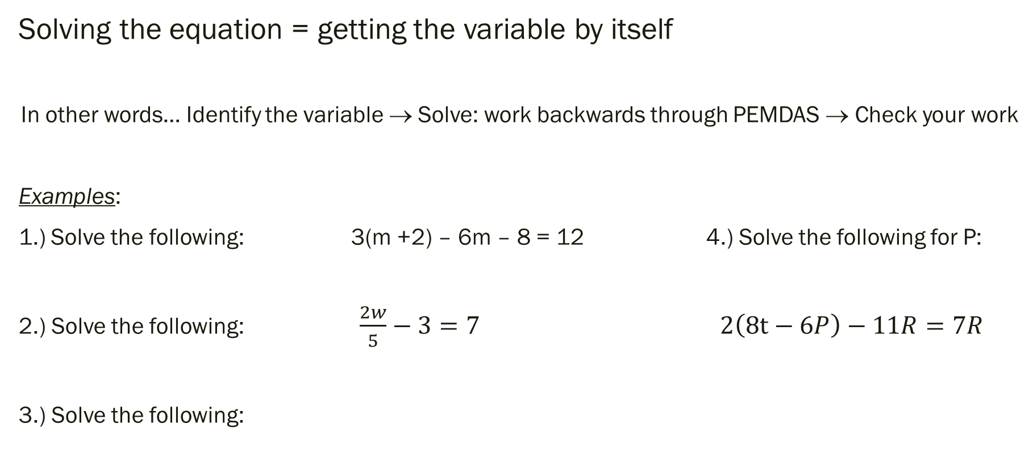
1.4 Solving Equations (note: now has = sign)
Solving the equation = getting the variable by itself
In other words… Identify the variable → Solve: work backwards through PEMDAS → Check your work
Examples:
1.) Solve the following: 3(m +2) – 6m – 8 = 12 4.) Solve the following for P:
2.) Solve the following: $\frac{2w}{5}−3=7$ $2\left(8t−6P\right)−11R=7R$
3.) Solve the following:

Slide 8
Quick Check for Understanding
In your own words what is the difference between an expression and an equation?
In your own words why do you evaluate an expression, but solve an equation?
When working with evaluating expressions, do you do multiplication before or after division?

Slide 9
For Next Time…
From Today:
Page 22 #3, 15, 21, 25, 31, 39
Page 30 #11, 14, 15, 27, 32, 36, 43, 52
Mixed Review:
Page 24 #67, 68, 73
Page 32 #72, 76, 78

